Slide 1
Agile Coaching
Dirk Riehle, FAU Erlangen
AMOS B06
Licensed under CC BY 4.0 International

Slide 2
Agenda
Agile coaching
Process improvement
Sprint retrospectives
Release retrospectives
Project retrospectives
Documentation

Slide 3
1. Agile Coaching

Slide 4
Agile Coaching
A coach is a person in relationship to another person or team who
Guides, collaborates, and supports the person or team
With respect to achieving their goals
An agile coach is a coach for agile teams
Agile coaches don’t make decisions or manage the team (unlike in sports)
Which is unfortunate given that Scrum is a sports metaphor
Agile coaching is what an agile coach does

Slide 5
Agile Coaching vs. Scrum Master
A Scrum Master helps a Scrum team
Perform at highest possible levels
An agile coach is a Scrum Master
With a broader outlook than just Scrum

Slide 6
The AMOS Coach
The AMOS coach is a Scrum Master
For the purposes of the development project
The AMOS coach goes beyond being a Scrum Master by
Conceiving and performing a team workshop

Slide 7
2. Process Improvement

Slide 8
Process Improvement
Process improvement is the practice of
Continuously improving a team’s performance by
Observing, reflecting on, and adapting the team’s behavior

Slide 9
Retrospectives [1]
In Scrum, process improvement is triggered through retrospectives
A retrospective is …
[1] Kerth, N. (2001). Project Retrospectives. Addison-Wesley.

Slide 10
Kerth’s Prime Directive
“Regardless of what we discover, we understand and truly believe that everyone did the best job they could, given what was known at the time, their skills and abilities, the resources available, and the situation at hand.” (ibid.)

Slide 11
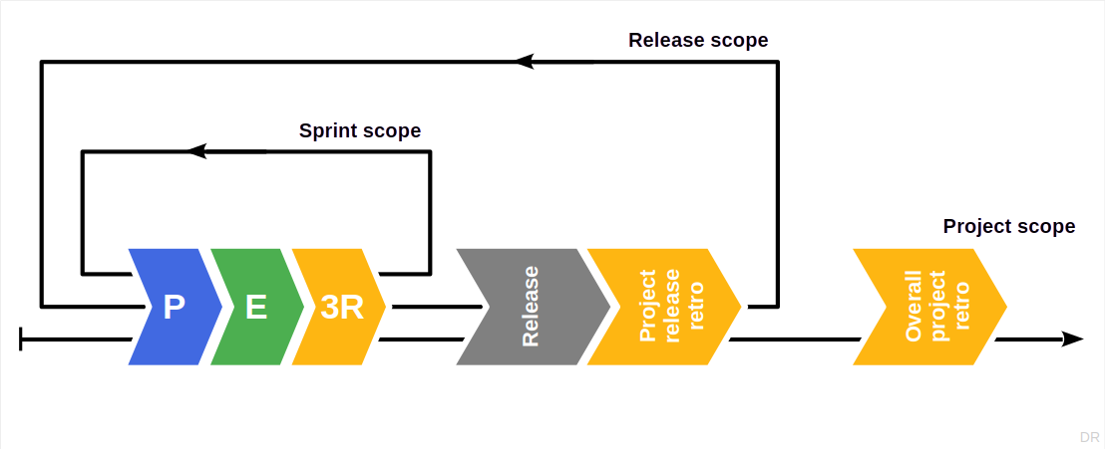
Retrospectives in Scrum

Slide 12
3. Sprint Retrospectives

Slide 13
Sprint Retrospective
A sprint retrospective is a retrospective that
…

Slide 14
4. Release Retrospectives

Slide 15
Release Retrospective
A release retrospective is a retrospective that
…

Slide 16
5. Project Retrospectives

Slide 17
Project Retrospective (a.k.a. Post-Mortem)
A project retrospective is a retrospective that
…

Slide 18
6. Documentation

Slide 19
Regular Deliverable: Documentation
Please create an initial documentation and keep it up-to-date

Slide 20
Summary
Agile coaching
Process improvement
Sprint release retros
Project release retros
Project retrospective
Documentation

Slide 21
Thank you! Any questions?
dirk.riehle@fau.de – https://oss.cs.fau.de
dirk@riehle.org – https://dirkriehle.com – @dirkriehle

Slide 22
Legal Notices
License
Licensed under the CC BY 4.0 International license
Copyright
© Copyright 2009-2025 Dirk Riehle, some rights reserved

